Slide 1
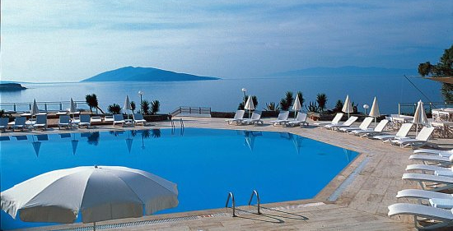
Antalya Bilim University TELP (Tourism Experiential Learning Program)
February 2023

Slide 2
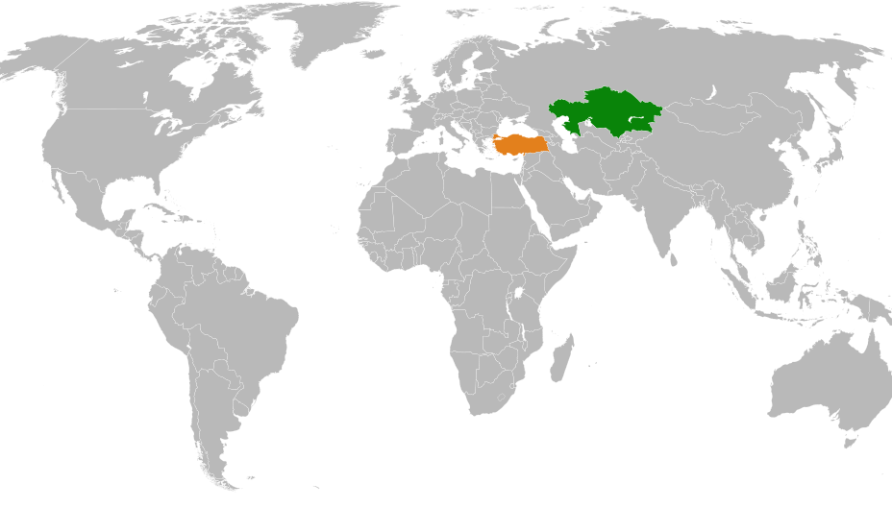
ABU TELP
Work experience
+
Study abroad
+
Living abroad
Kazakhstan – Türkiye
Tourism Human Resources
Training and Education Cooperation

Slide 3
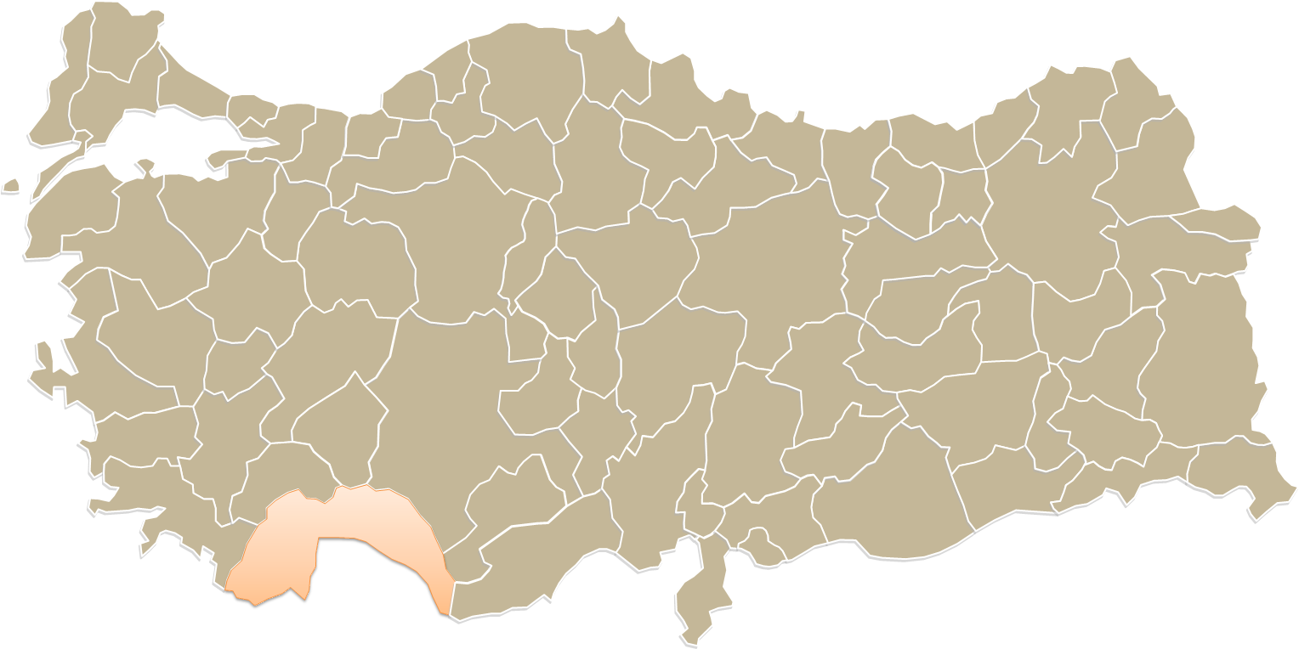
ABU TELP
Work experience
+
Study abroad
+
Living abroad
Antalya;
Located South Türkiye on the Medditeranean Sea coast
509 five star resort Hotels + 2000 Hotels
Tourism Capital of Türkiye

Slide 4
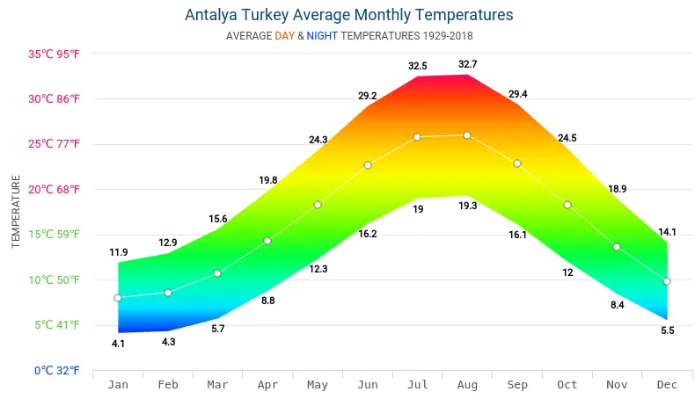
Antalya
More than
300 sunny days
Every year
Pearl of the country between
the Taurus Mountains and
the Mediterranean Sea.

Slide 5
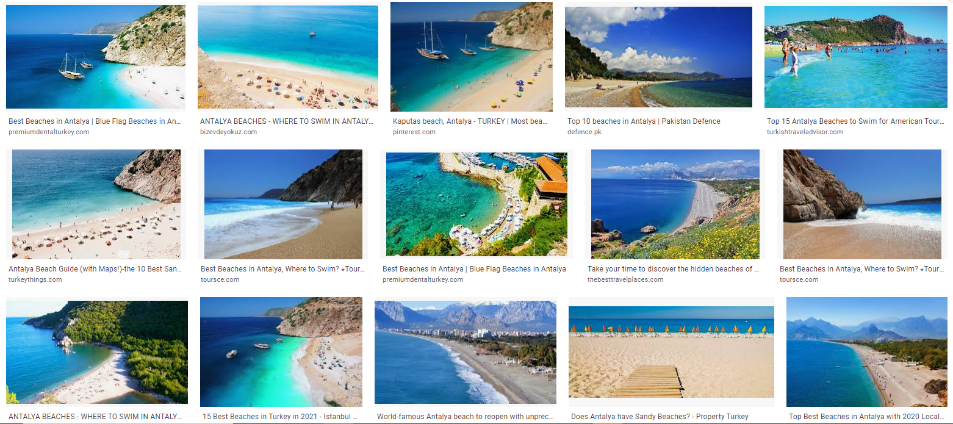
So many beaches in Antalya: 640 km coast line

Slide 6
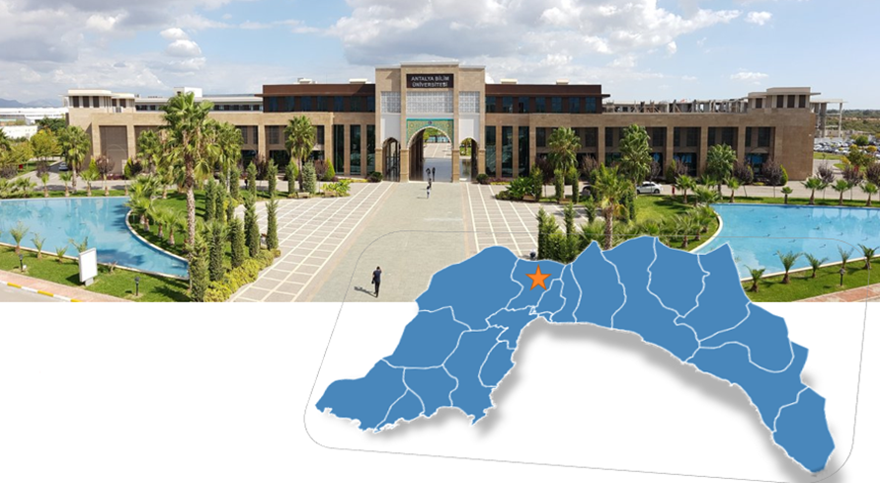
ABU Döşemealtı Campus
Established in 2010

Slide 7
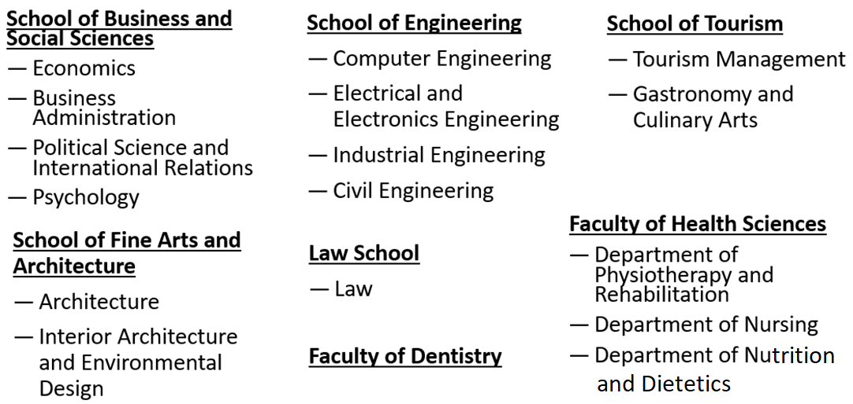
Antalya Bilim University

Slide 8
ABU School of Tourism
ABU School of Tourism:
Tourism Management
Gastronomy and Culinary Arts
1 year English prep school
+ 4 years undergraduate program
International students:
Established in 2010
First graduates in 2017
Kazakhstan
Russia
Germany
Azerbaijan
Turkmenistan
Kirghizstan
Jordan
Libya
Iran
Pakistan
Rouwanda
Others

Slide 9
ABU TELP
Students gain experience in studying, working and living in Türkiye.
This year, TELP will be held for the third time.
In the past two years, TELP has welcomed 226 Kazakh students from 7 different universities.
Successful ABU TELP students:
Can participate in the programme next year again. You can apply for TELP many times.
Depending on their TELP performance such students may be employed by Rixos Hotels in Kazakhstan in the future.
Work experience
+
Study aborad
+
Living abroad

Slide 10
ABU TELP Time Table
Arrival at Antalya
For TELP 2023, students must arrive at Antalya Airport from the beginning of March to mid-March 2023.
TELP Exchange Courses and Internship
The exchange courses will be held intensively from mid-March until mid-April.
The final exams will be held in September/October.
Students carry out their TELP internships until the end of October.

Slide 11
ABU TELP
Exchange Courases | ECTS | Total Class Hours
TRM 500 Internship | 19
TURK101 Turkish Language | 2 | 24
TRM373 Ancient Cities and Tourism | 5 | 42
TRM108 Sanitation and Hygiene and Occupational Safety | 4 | 42
Total | 30 | 112
Work experience
+
Study aborad
+
Living abroad
Grading for Exchange courses
Midterm exam
Final exam
Projects, presentations, quizes, assignments, homework
Writing internship reports periodically
Schools in Kazakhstan can recognise these courses in their curriculum

Slide 12
ABU TELP
ABU is legal guardian of students
Rixos Hotels and Corendon Hotels are partner Hotels (5 star) providing work experience and accommodation
ABU advisor will supervise students in class
ABU internship coordinators will audit students at work
Work experience
+
Study aborad
+
Living abroad

Slide 13
ABU TELP
ABU will provide transcript for the Exchange courses and a Certificate for TELP
70% attendance to classes are compulsory
Students will attend online classes at Rixos and Corendon Hotels meeting room
Students will watch video record of lessons in whenever they want
Work experience
+
Study aborad
+
Living abroad

Slide 14
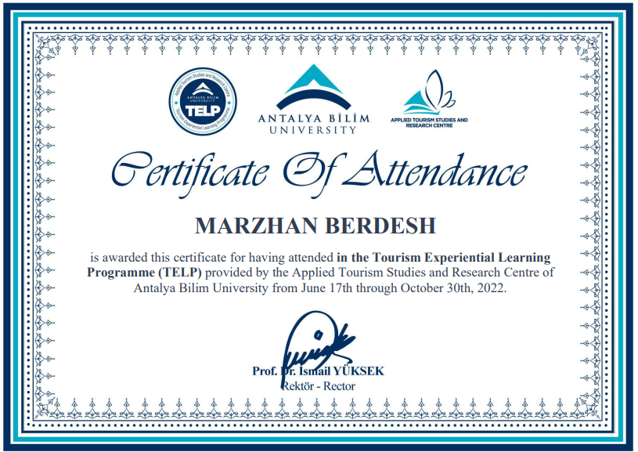
ABU TELP
Work experience
+
Study aborad
+
Living abroad

Slide 15
ABU TELP
Grading for TELP internship =
60% Rixos + 40% ABU advisor
Work discipline,
Ability to work in a team and alone,
Coming to work on time,
Following instructions of managers,
Work experience
+
Study aborad
+
Living abroad

Slide 16
ABU TELP
Can students change their departments every week? Will they be assigned to a specific department or will they rotate?
Gaining work experience is the heart of the ABU TELP programme. Each student must gain enough experience in the core department. If the student learns fast and if there is an opportunity to experience another department, partner hotel HR managers will appoint a different position for the student.
Work experience
+
Study aborad
+
Living abroad

Slide 17
ABU TELP
Can I leave early?
The dates you agree with partner hotel can only be changed with permission of the ABU TELP Committee.
Students are subject to the following terms if they withdraw from the TELP programme prior to completion without an ABU TELP Committee-approved reasoning:
The university (PU) in Kazakhstan shall initiate a disciplinary investigation against the offending student. The PU's disciplinary board shall include a representative from the ABU.
The report of the disciplinary investigation is issued to the ABU and the relevant hotel upon completion of the investigation.
The travel expenses must be reimbursed by the student.
Work experience
+
Study aborad
+
Living abroad

Slide 18
ABU TELP
Can female students wear hijab/headscarves during their work at the hotel?
Wearing a headscarf is no problem while working. The work place and position of the students will be determined by partner hotels, which welcome all nationalities, all cultures, and all beliefs.
Work experience
+
Study aborad
+
Living abroad

Slide 19
ABU TELP
Work/ Internship: Rixos and Corendon Hotels
Accommodation: Rixosand Corendon personnel lodging
Audits:
Internship audit – ABU teacher and Supervisors at the Hotels
Exchange Courses– ABU teacher
Work experience
+
Study aborad
+
Living abroad

Slide 20
ABU TELP
For successfull face to face/online courses
You need mobile phone or laptop
Camera, microphone are needed
Headphone recommended
Internet (Wifi) provided by the Hotels
Work experience
+
Study aborad
+
Living abroad

Slide 21
ABU TELP
ABU TELP free services
Flight from city of school
Visa
Airport-Hotel transfer
Accommodation
Meals
Health services at Hotel and government hospital
Uniform + washing & ironing services
ABU Exvhange courses + TELP internship
Hotels on the job training
+ earning pocket Money
Work experience
+
Study aborad
+
Living abroad

Slide 22
ABU TELP
Health insurance
TELP students have access to limited private health insurance while on TELP.
Starting on the 30th day of the internship, TELP students are also covered by government insurance.
Work experience
+
Study aborad
+
Living abroad

Slide 23
ABU TELP
Pocket money
TELP students will begin receiving USD 100-130 pocket money from the partner hotel at the end of the month in which their internship began.
If there are less than 30 days of internship in a month the days worked will be counted for pocket money.
When will students get paid their pocket money?
Students are advised to bring money with them for the start. Students receive their USD 100 -130 pocket money after completing their first 30 days of their internship.
Work experience
+
Study aborad
+
Living abroad

Slide 24
ABU TELP
Communication between parents and students and schools
ABU internship coordinator
Kazakh teacher in Kazakhstan
Telephone number with WhatsApp
Work experience
+
Study aborad
+
Living abroad

Slide 25
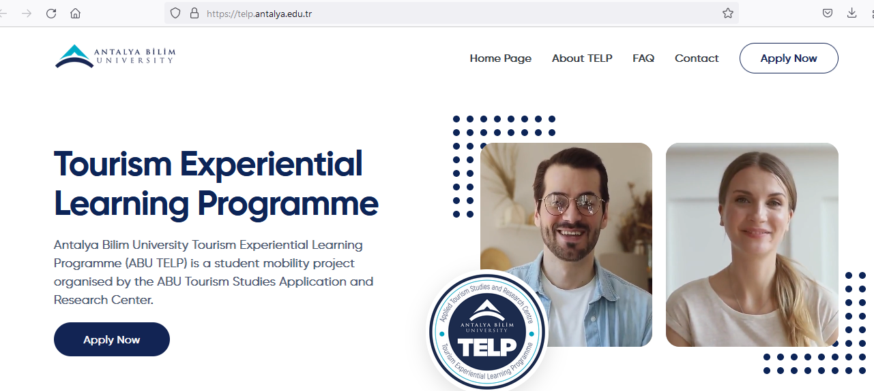
ABU TELP online application
How to apply? Online from https://telp.antalya.edu.tr/

Slide 26
ABU TELP
ABU TELP online application
Important notice!!!
Students neglected to upload biometric printed photos and used the incorrect English alphabet on their applications last year (Please do not use Cyrillic characters).
Please do not make these errors this year.
Work experience
+
Study aborad
+
Living abroad

Slide 27
If you use Cyrillic characters, the system will not recognise your application

Slide 28
ABU TELP
After arrival in Antalya, the following documents are necessary:
1. A copy of the entry page in your passport
2. Submit six biometric printed photos to the ABU International Office.
3. Fill out and sign the internship application form provided by the ABU International Office.
4. Fill out and sign the commitment document given by the ABU International Office.
5. Sign the printed application form given by the ABU International Office.
6. Sign the residence permit application form given by the ABU International Office.
Work experience
+
Study aborad
+
Living abroad

Slide 29
ABU TELP
For questions please contact with:
cagla.mckenzie@antalya.edu.tr
caner.unal@antalya.edu.tr

